Slide 1

CAR WASH PREDICTION

Slide 2
01
02
03
ABOUT DATA
EDA
preprocessing
TABLE OF CONTENTS
04
05
06
MODELING
PIPELINE
DEPLOYMENT
Understanding data and goal
analysis
Drop ,nan ,outliers,and dummies ,split data
Train model
Generate automatic process
streamlit

Slide 3

01
About Data

Slide 4
About Data
description
Cars dataset with features including make, model, year, engine, and other properties of the car used to predict its price.
1
Source
Structure
Kaggle
4
2
Columns >>16
Rows>>11.9K
Columns
3
Description of columns

Slide 5
02
EDA

Slide 6
EDA
Handling nan values
Handling duplicate data
Univariate Analysis
Bivariate Analysis

Slide 7
Handling nan values
Engine Fuel Type
Engine HP
Engine Cylinders
Number of Doors
Market Category

Slide 8
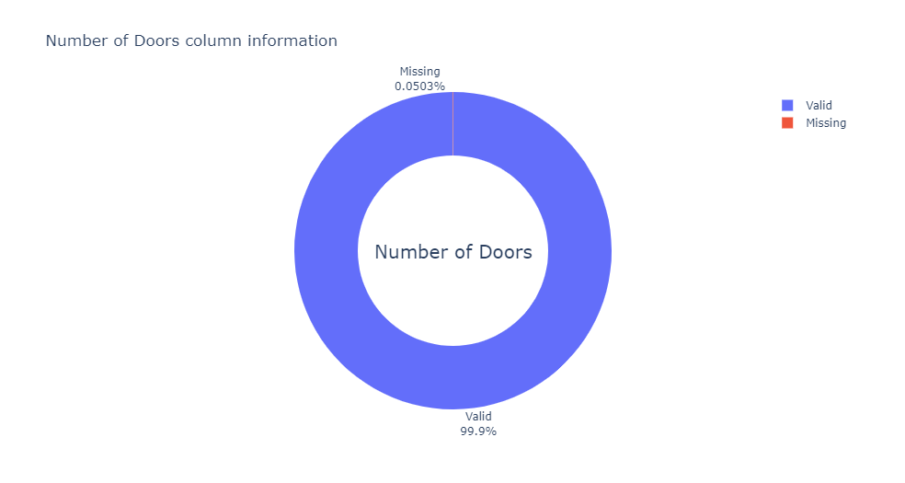
Number of Doors pie

Slide 9
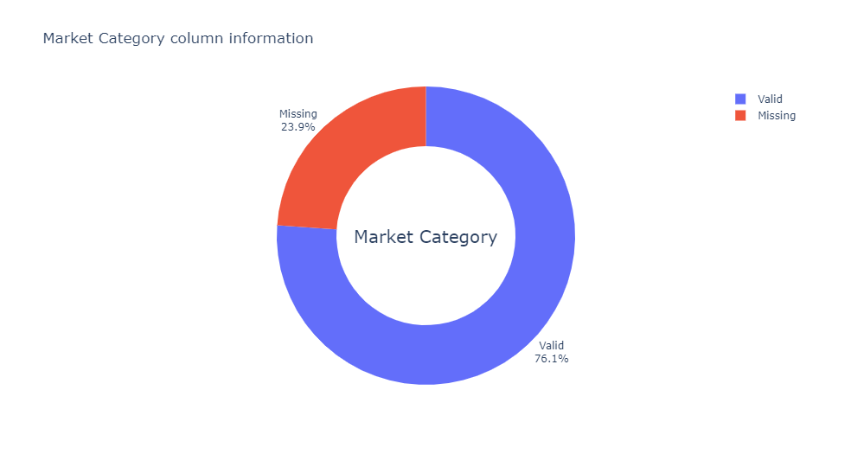
Market Category pie

Slide 10
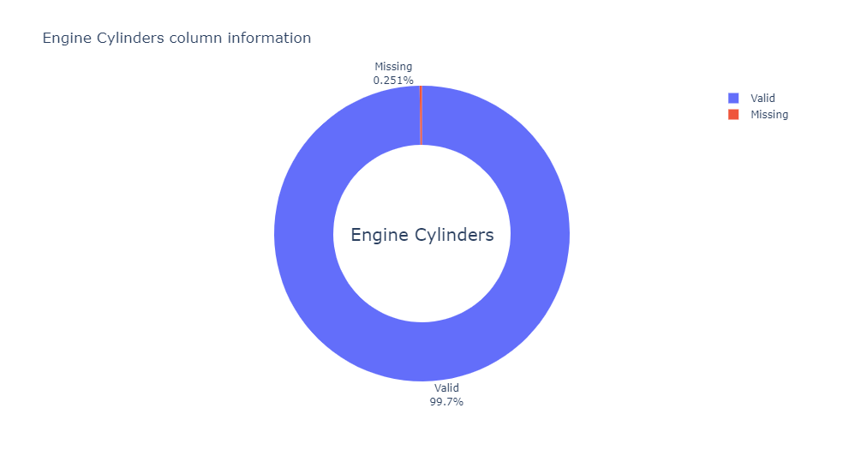
Engine Cylinders pie

Slide 11
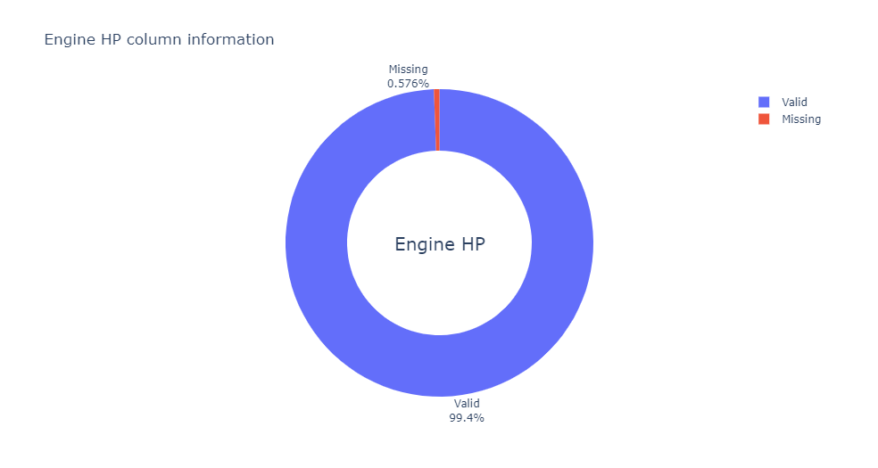
Engine HP pie

Slide 12
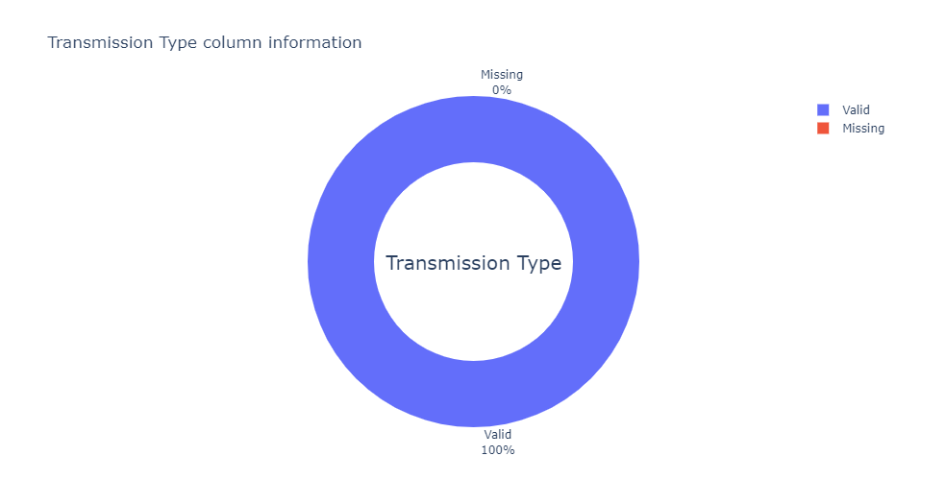
Transmission Type pie

Slide 13
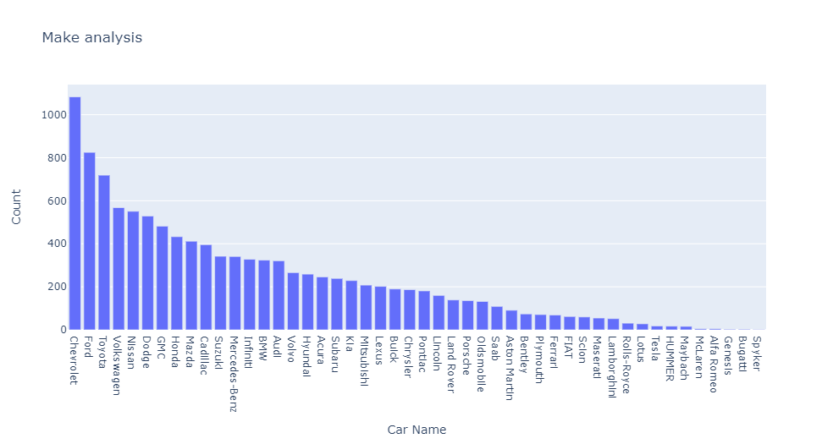
Univariate Analysis

Slide 14
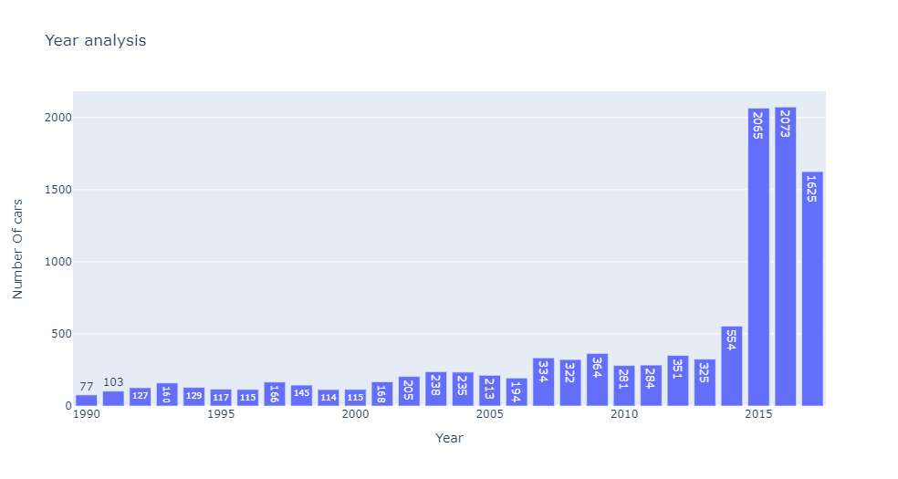
Univariate Analysis

Slide 15
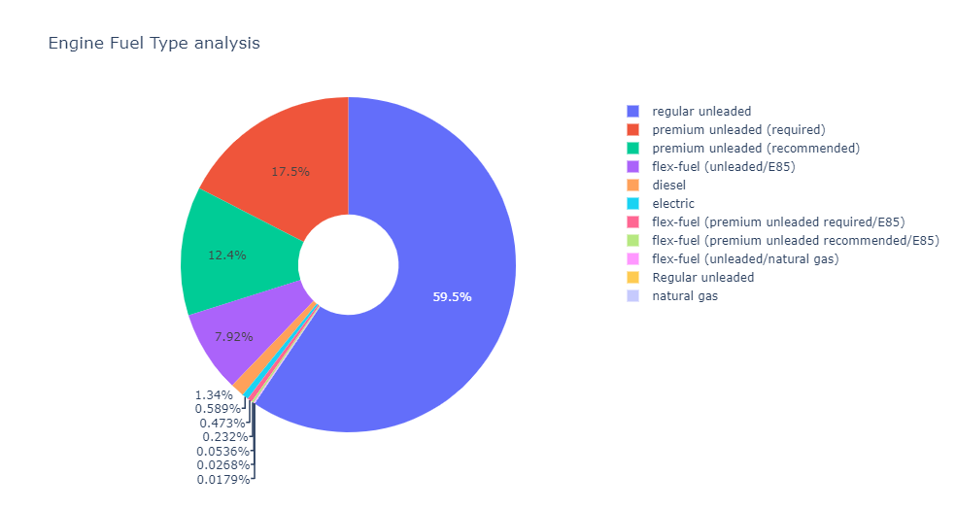
Univariate Analysis

Slide 16
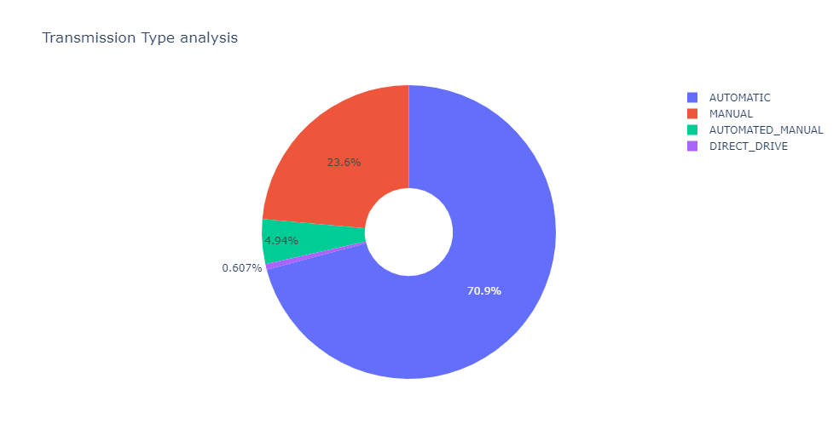
Univariate Analysis

Slide 17
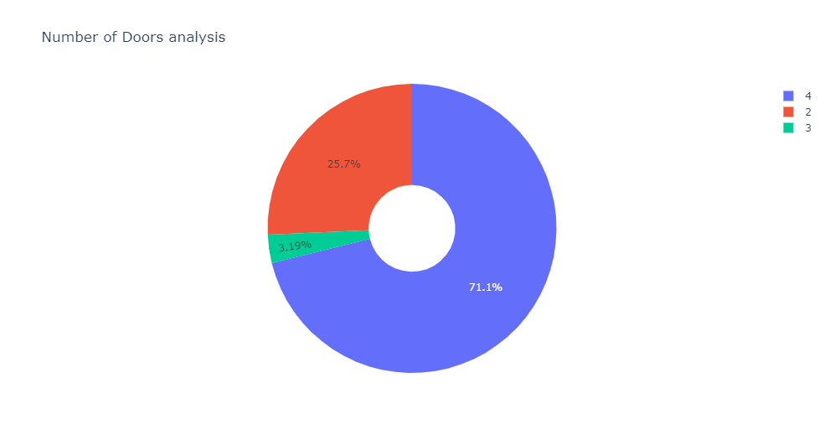
Univariate Analysis

Slide 18
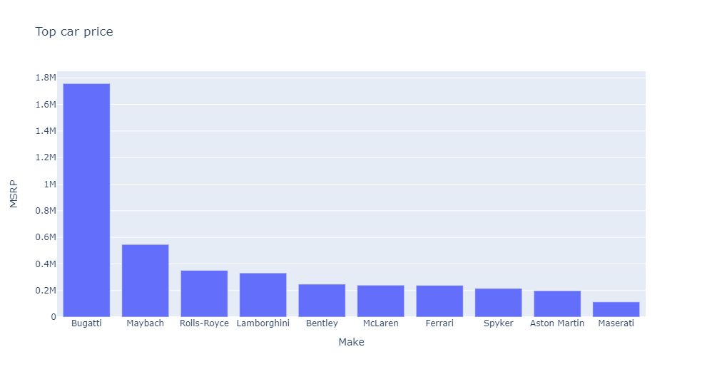
Bivariate Analysis

Slide 19
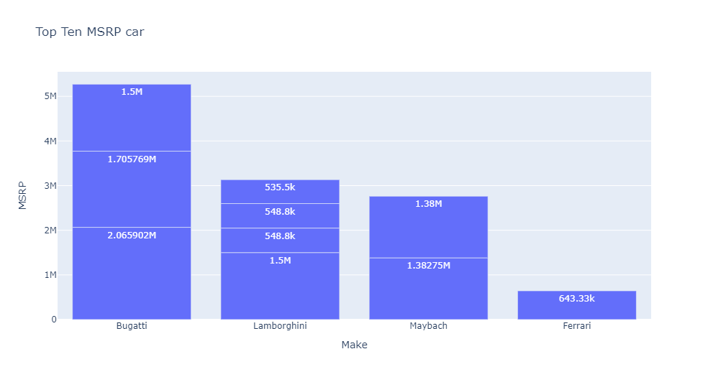
Bivariate Analysis

Slide 20
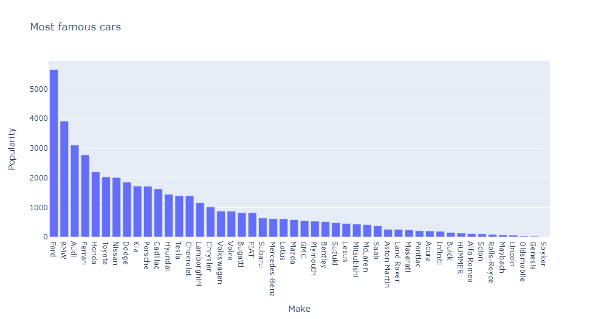
Bivariate Analysis

Slide 21
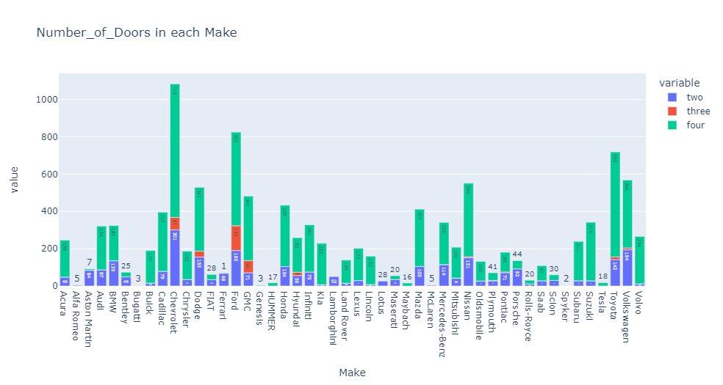
Bivariate Analysis

Slide 22
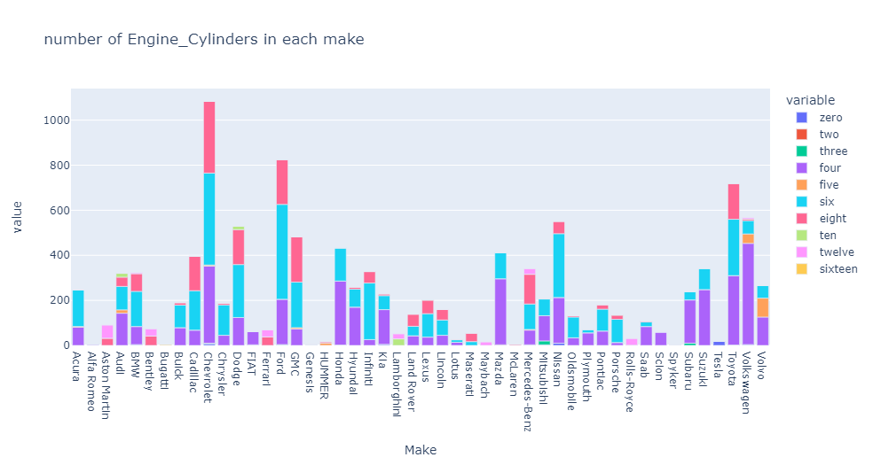
Bivariate Analysis

Slide 23
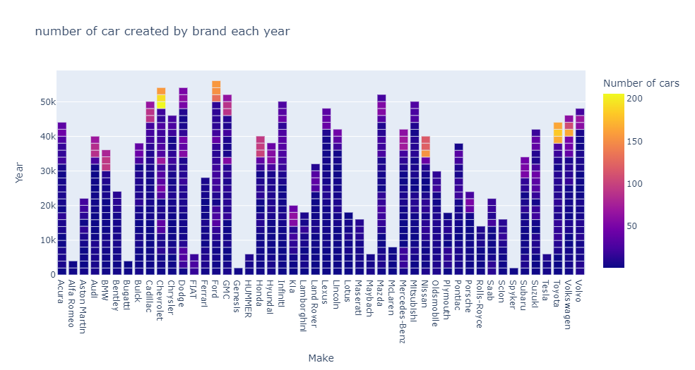
Bivariate Analysis

Slide 24
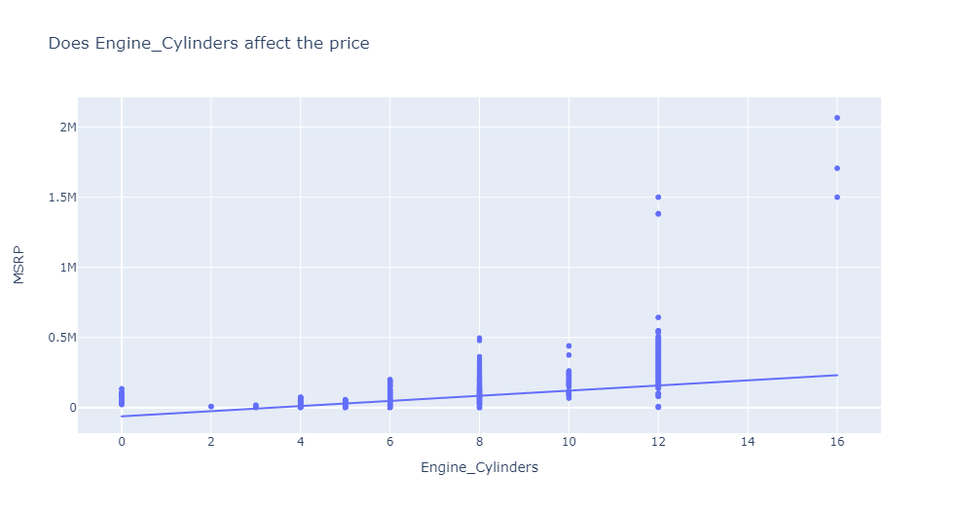
Bivariate Analysis

Slide 25
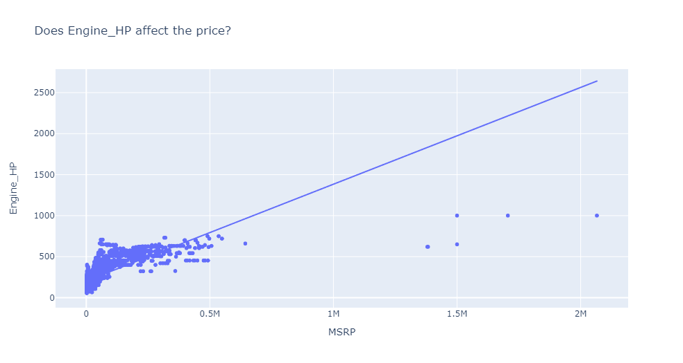
Bivariate Analysis

Slide 26
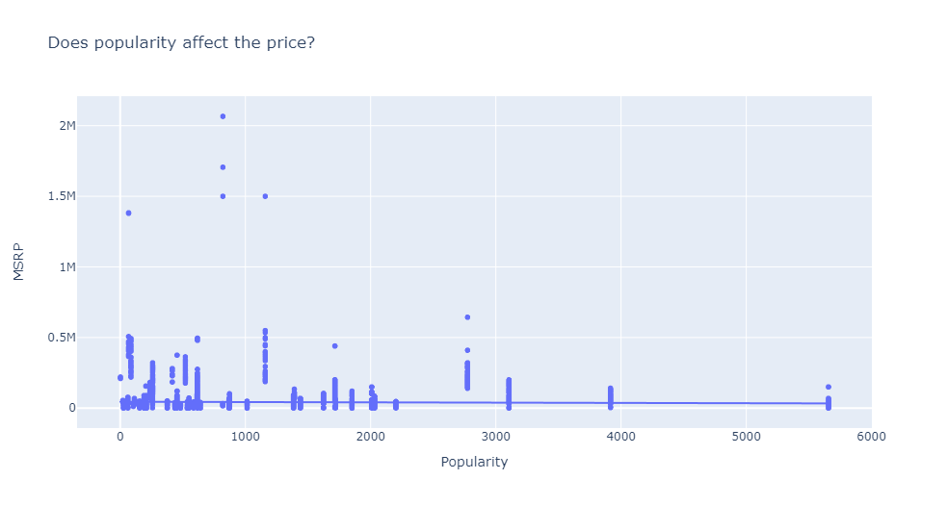
Bivariate Analysis

Slide 27
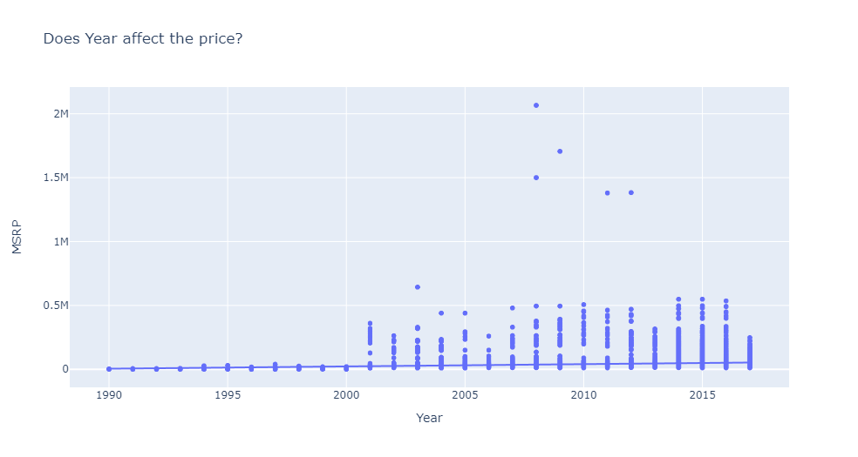
Bivariate Analysis

Slide 28
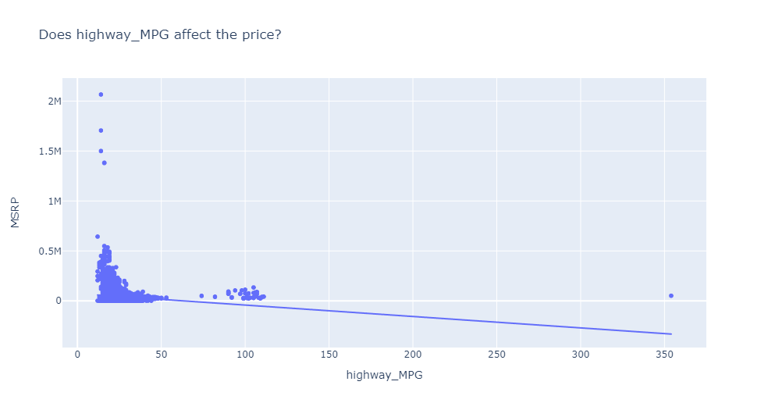
Bivariate Analysis

Slide 29
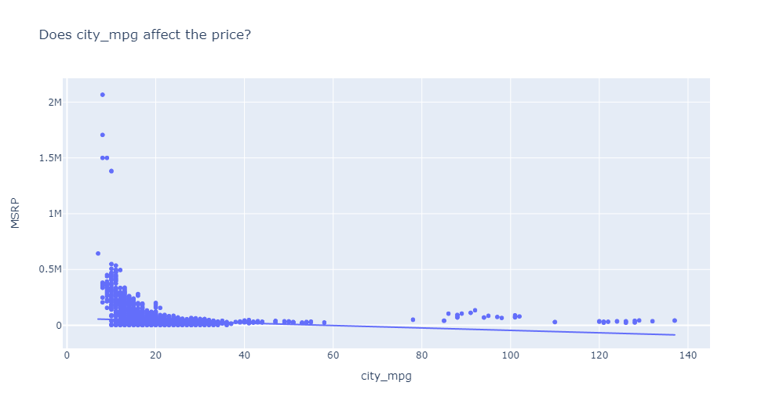
Bivariate Analysis

Slide 30
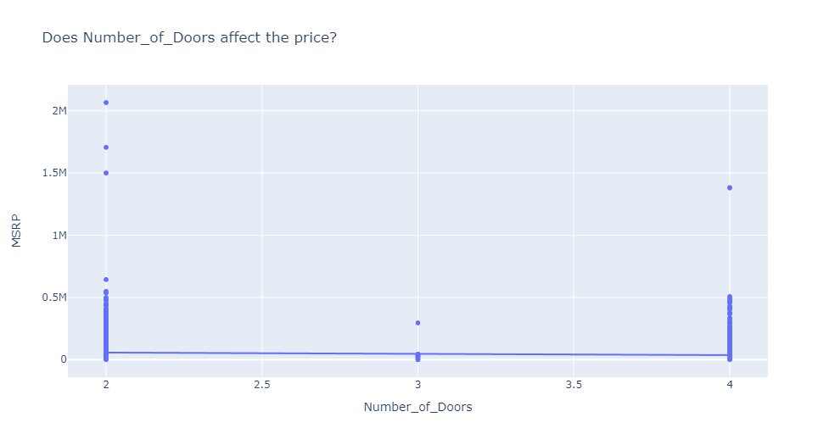
Bivariate Analysis

Slide 31
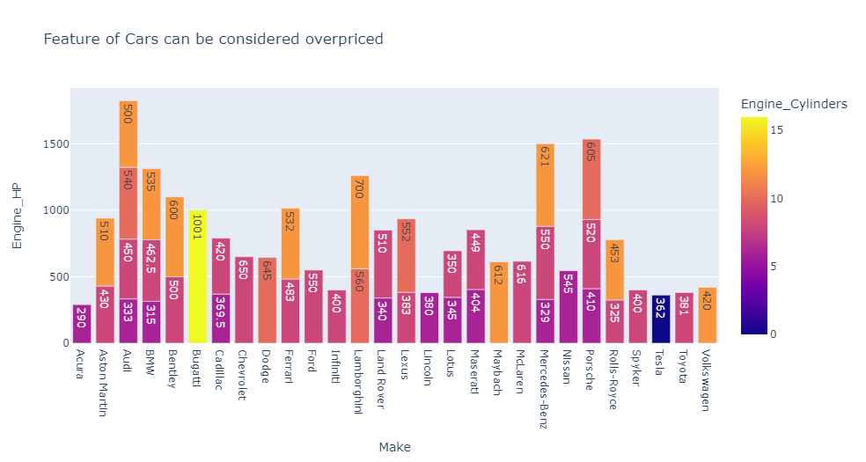
Bivariate Analysis

Slide 32
03
preprocessing

Slide 33
Split data to train and test
Get dummies
Handling outliers

Slide 34
Handling Outliers
IQR
Box plot

Slide 35
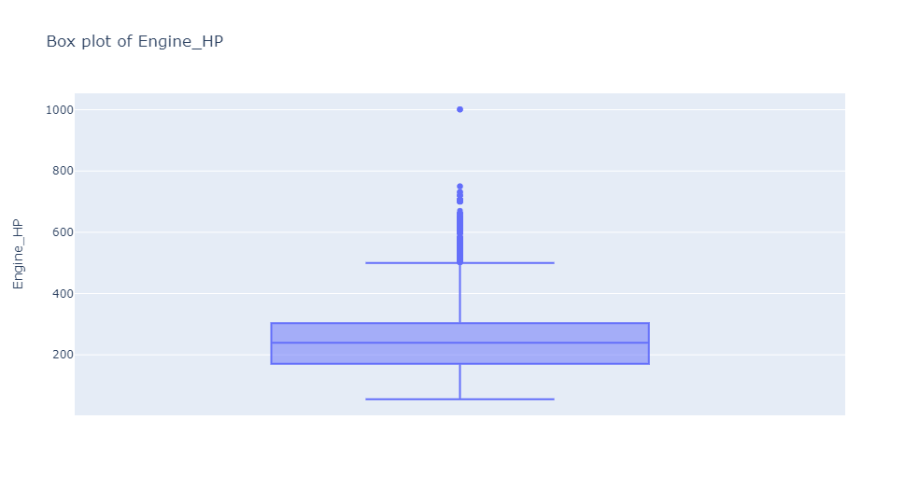
Box plot

Slide 36
Box plot

Slide 37
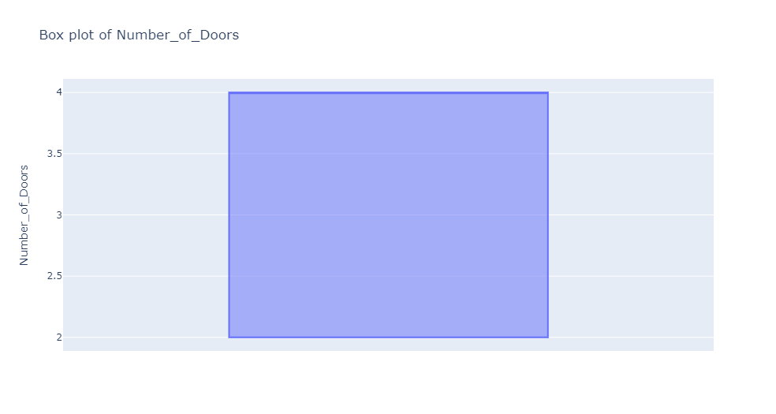
Box plot

Slide 38
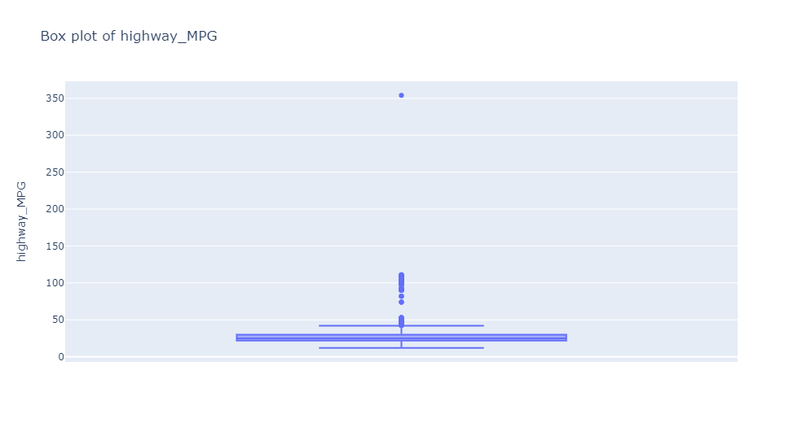
Box plot

Slide 39
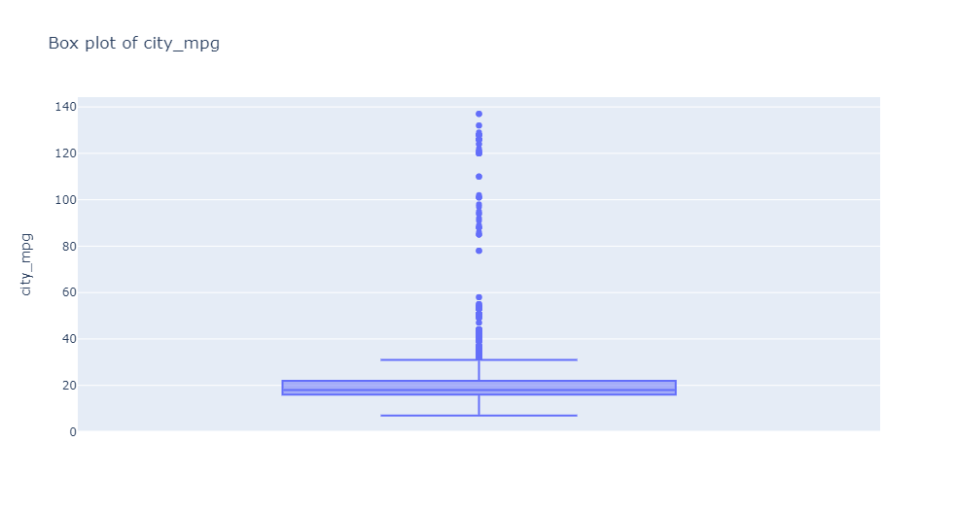
Box plot

Slide 40
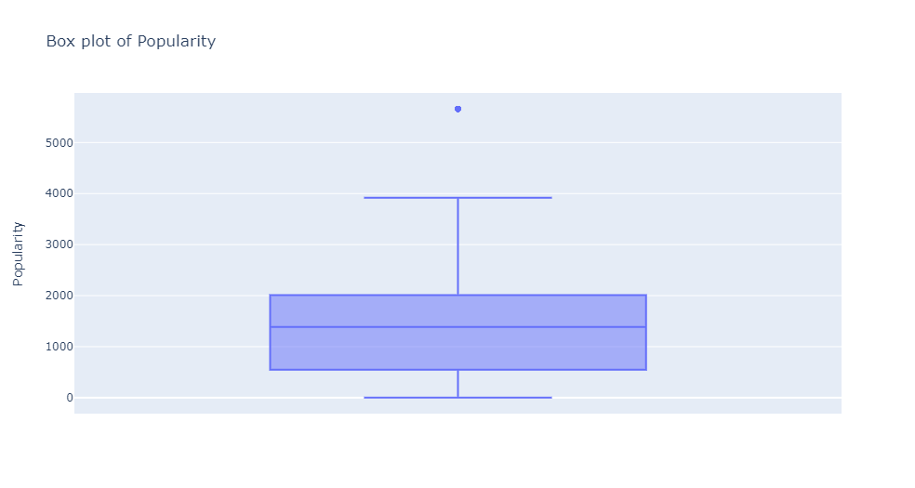
Box plot

Slide 41
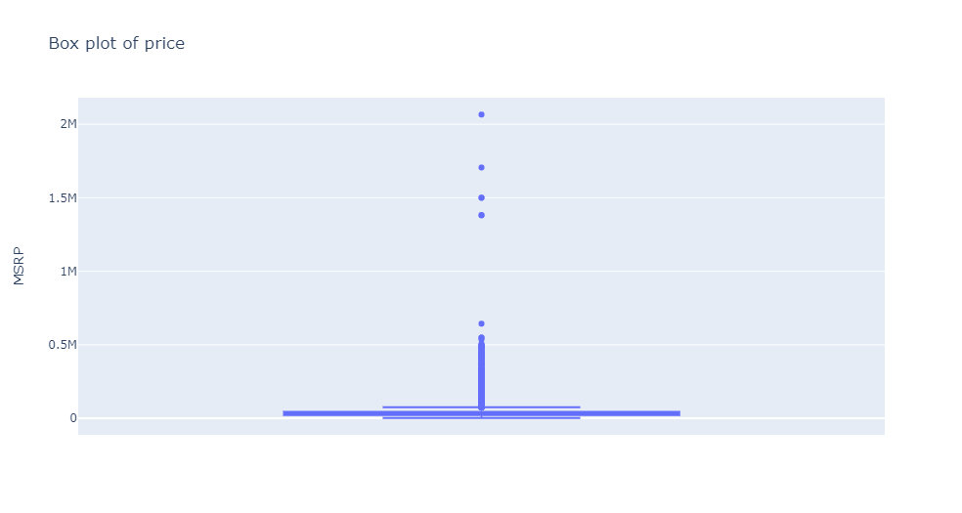
Box plot

Slide 42
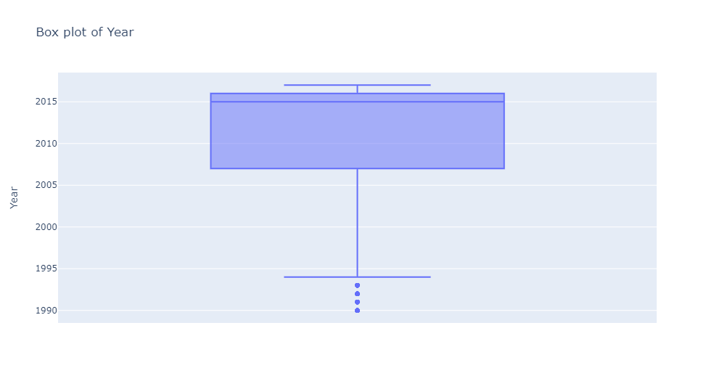
Box plot

Slide 43
04
Modeling

Slide 44
Modeling Steps
modify parameter
validate
choose
Best model
Apply
Model
Data
Scale
Feature selection

Slide 45
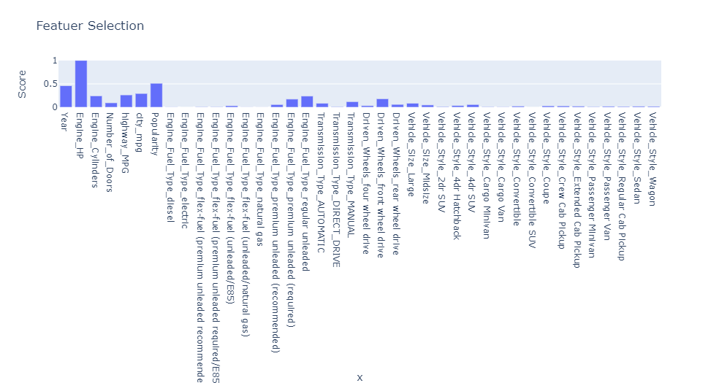
Feature Selection

Slide 46
Feature Selection
KNeighbors
SVR
lasso
DecisionTree
linear
XGBOOSt
RandomForest

Slide 47
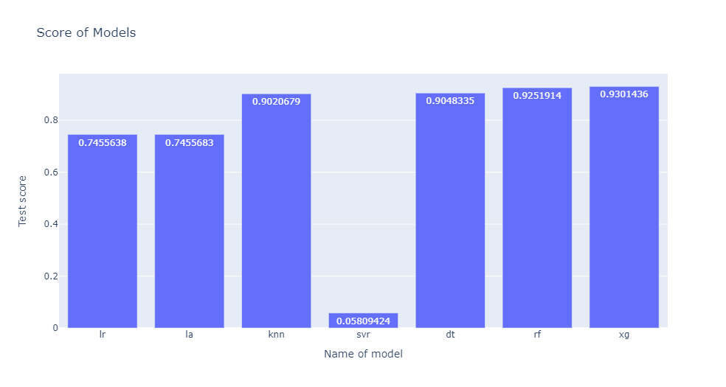
Choose best Model

Slide 48
05
Pipeline

Slide 49
Pipeline
Apply steps and model
Set steps

Slide 50
06
Deployment

Slide 51

THANKS
Does anyone have any questions?
memad0699@gmail.com
+201155704905

Slide 52
Use our editable graphic resources...
You can easily resize these resources, keeping the quality. To change the color, just ungroup the resource and click on the object you want to change. Then, click on the paint bucket and select the color you want. Don’t forget to group the resource again when you’re done.

